Slide 1
Write about your Black experience, and there will be no end of white people to tell you how you experienced your experience wrong -
Brian Broome

Slide 2
MADAME CHRISTIANE DOLORES

Slide 3
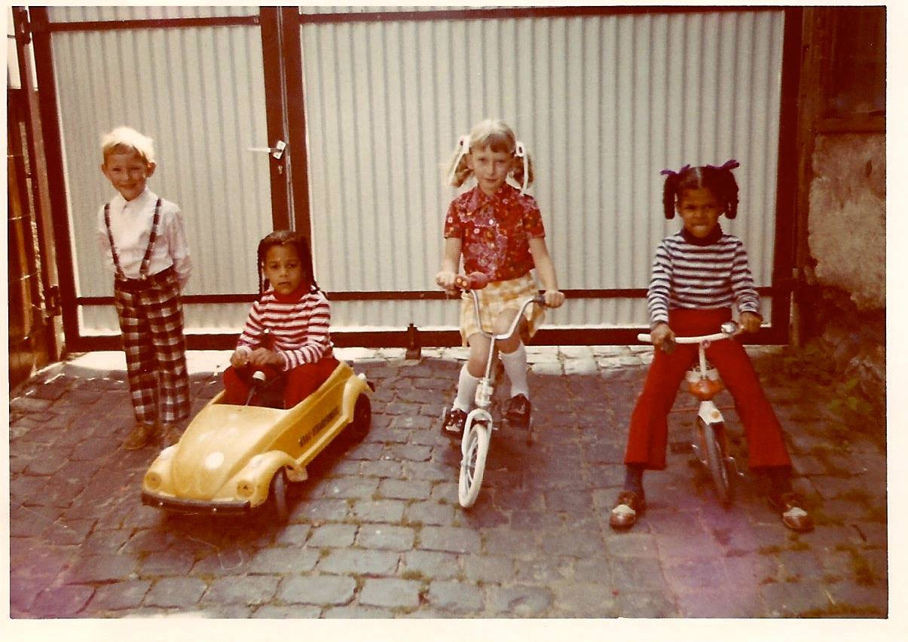
In Giessen, Germany with my Cousins

Slide 4
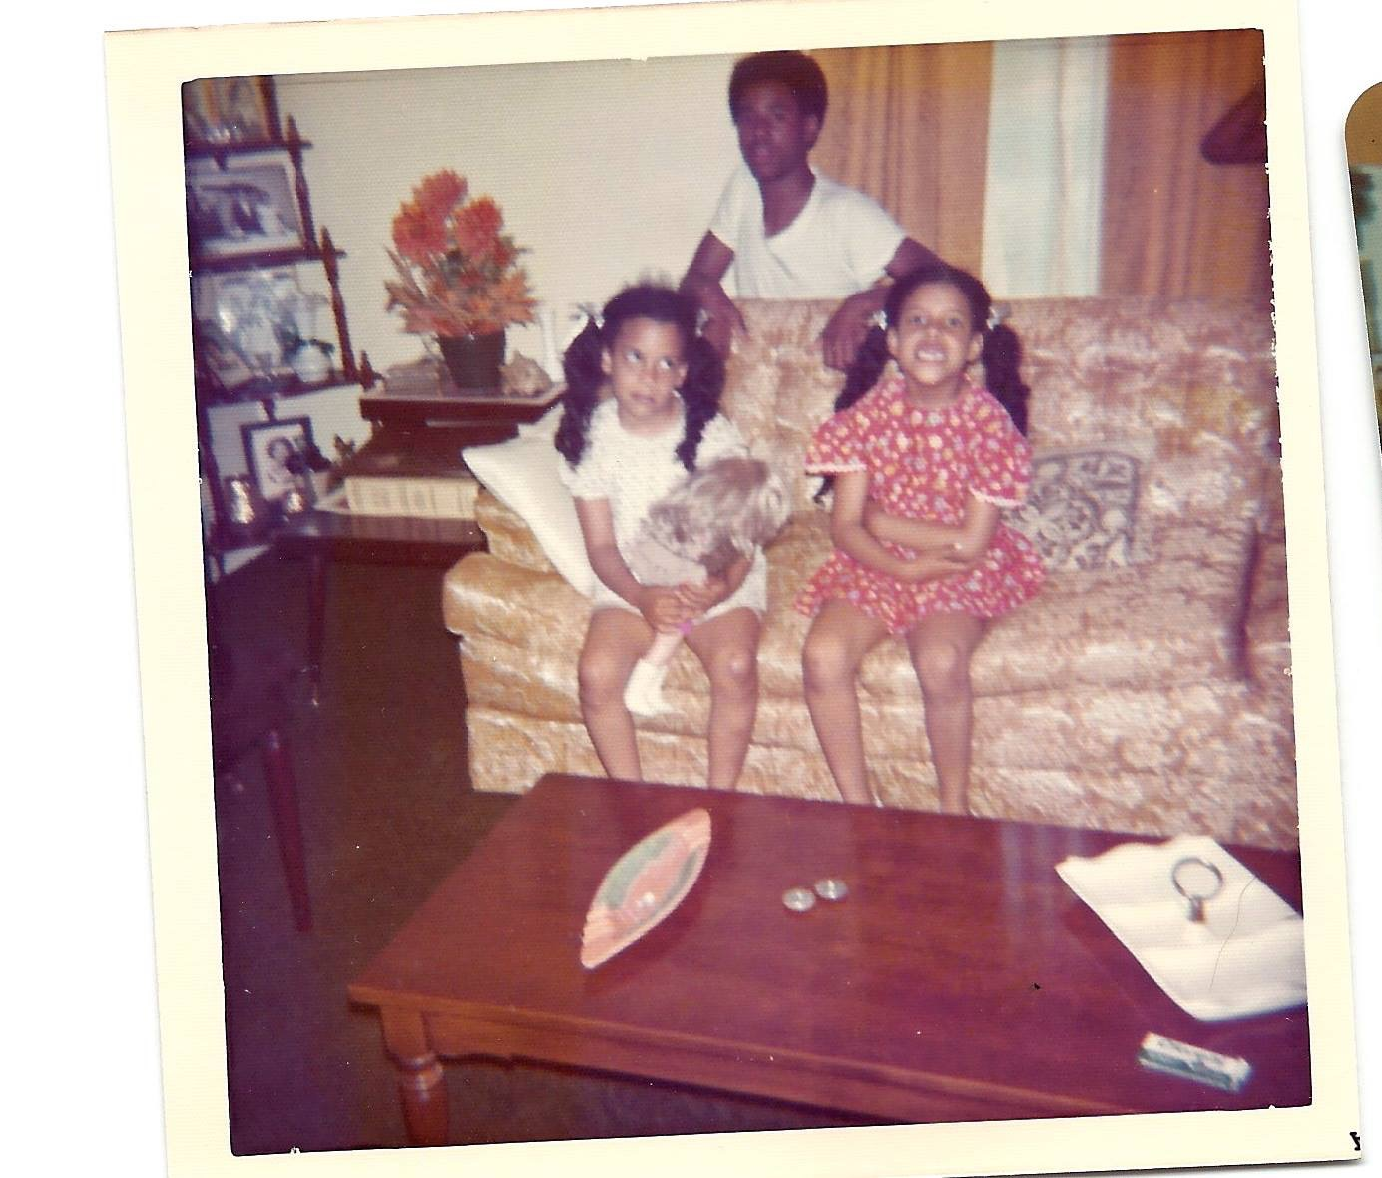
In North Carolina, USA, with my Cousins

Slide 5
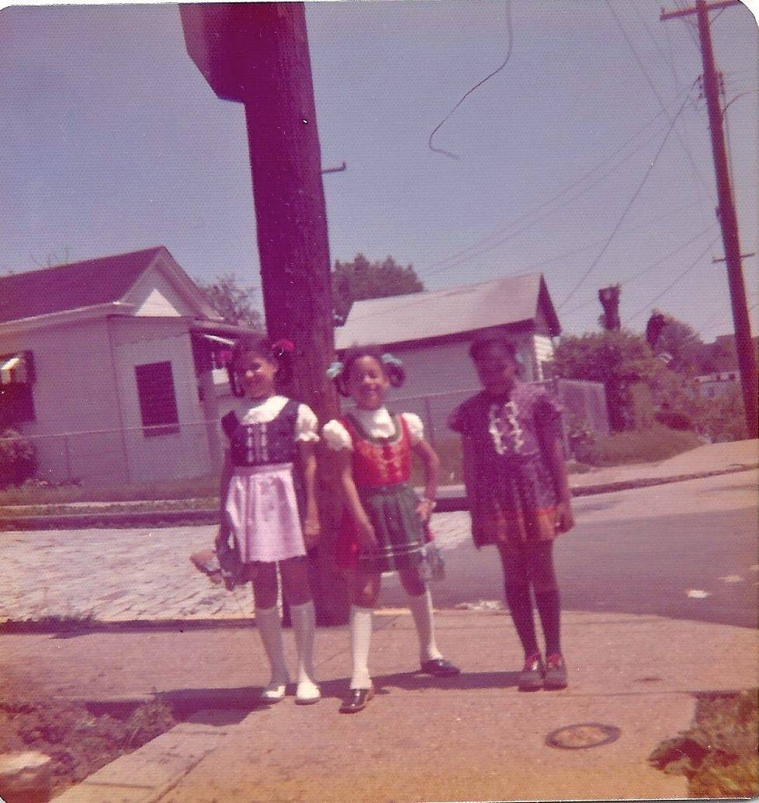
In Beltzhoover, Pittsburgh, our neighborhood, wearing our Dirndls

